Slide 1


Presented to:
Ms.Ramsha Khalid
TechKreative
Presented by
Moeez Ahmad
Hasnain Ali
Muhammad Arham
Syed Ali Asjad
Alishba Mahmood
Fatima Batool
Your All-in-One Digital Partner

Slide 2
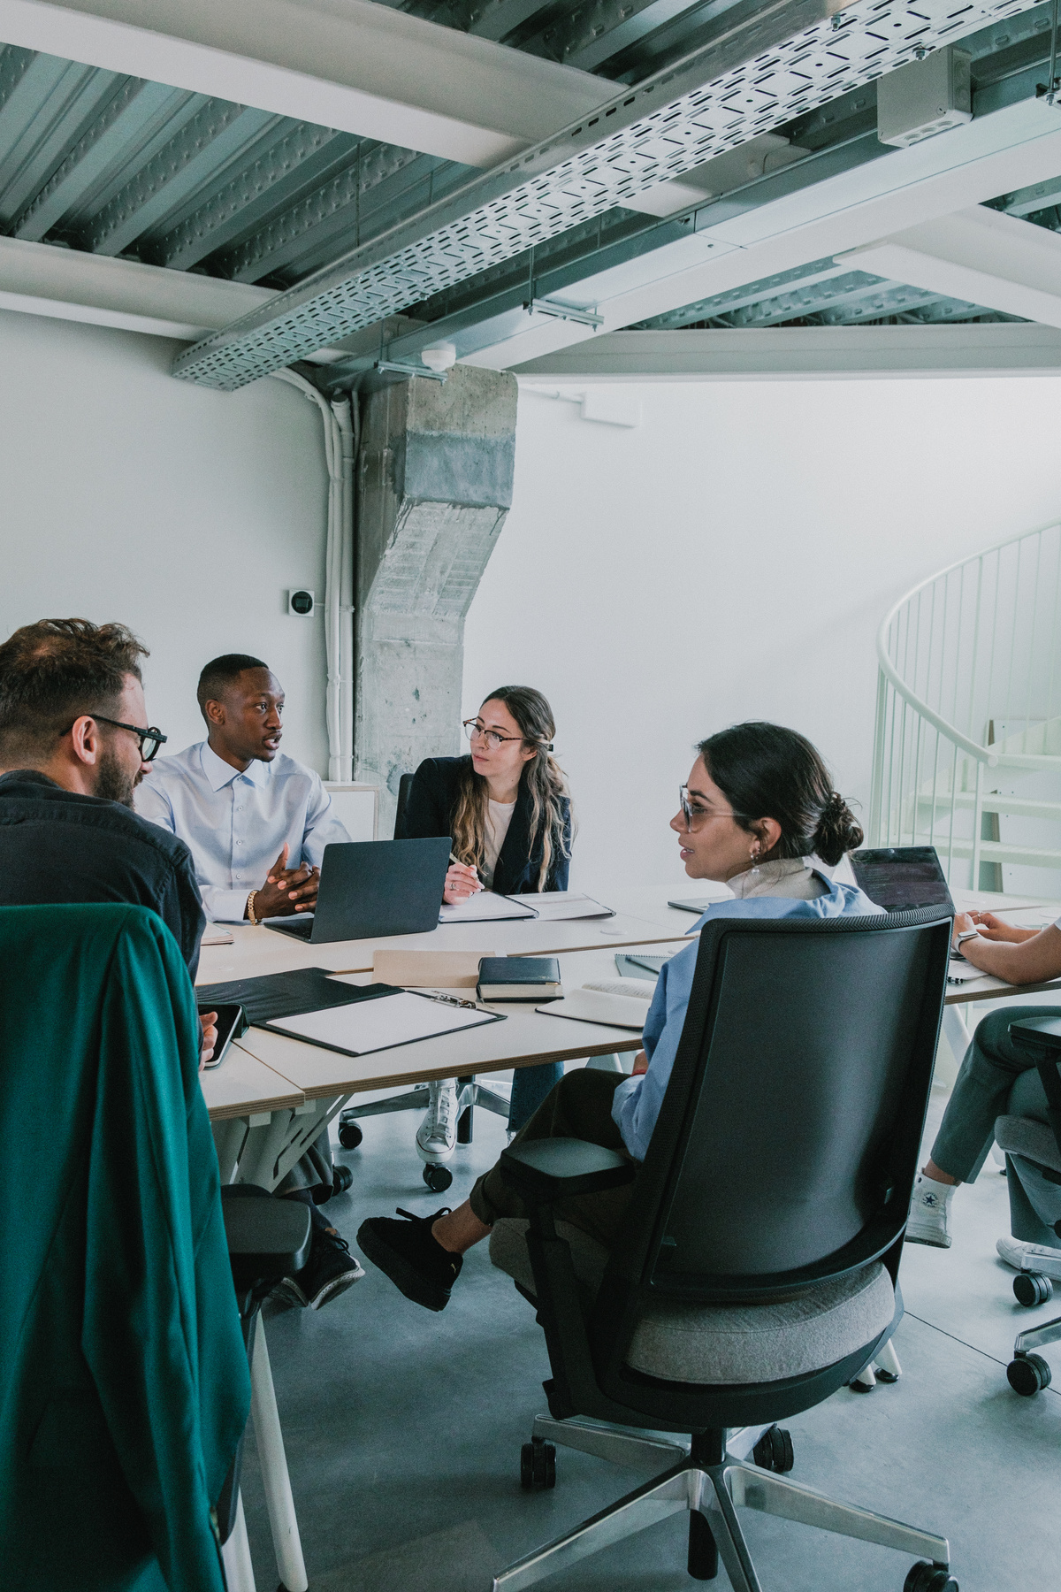
Objective
The main objective was that to build a website that showcase our tech startup portfolio, its earnings and in detail services overview
Agency
After discussion in our team we decided to build an agency named TechKreative which provide digital services and innovative solutions for your businesses and help them grow digitally

Slide 3

Procedure
According to the manual and our instructor we have to build a website that showcause our tech startup portfolio, its earning, calculations and detailed report about the startup.
Instructions

Slide 4
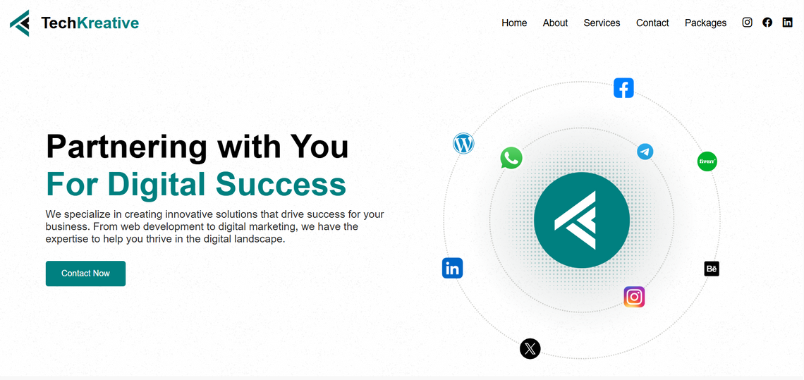
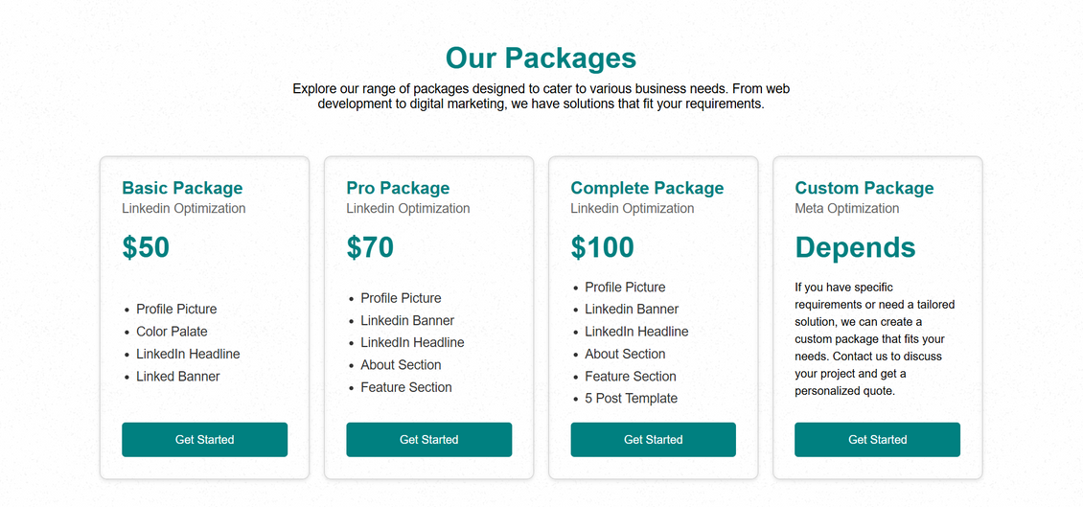
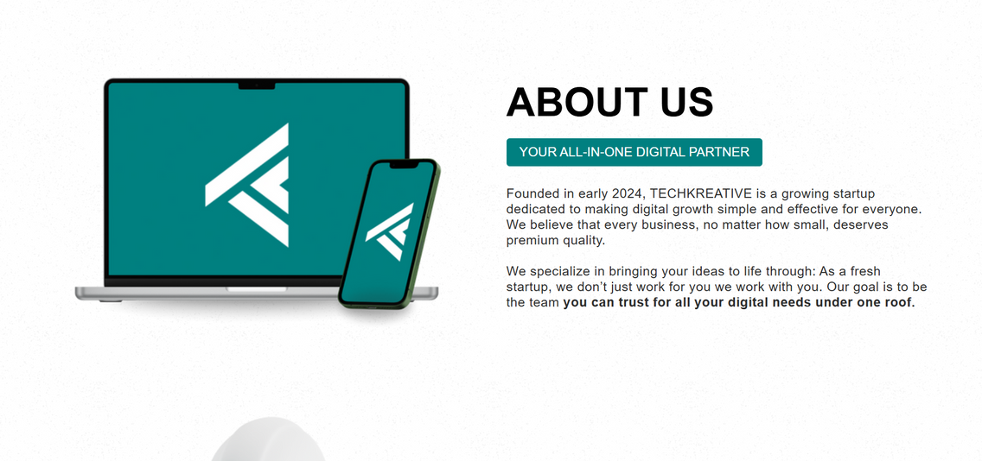
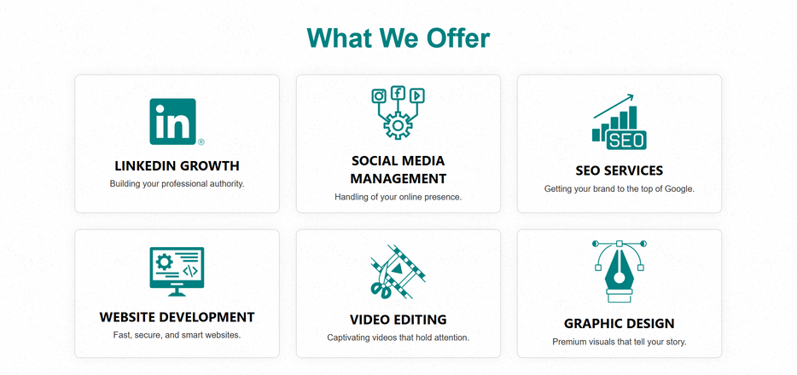
Website Overview
To visit our hosted site on github pages: Click Here

Slide 5
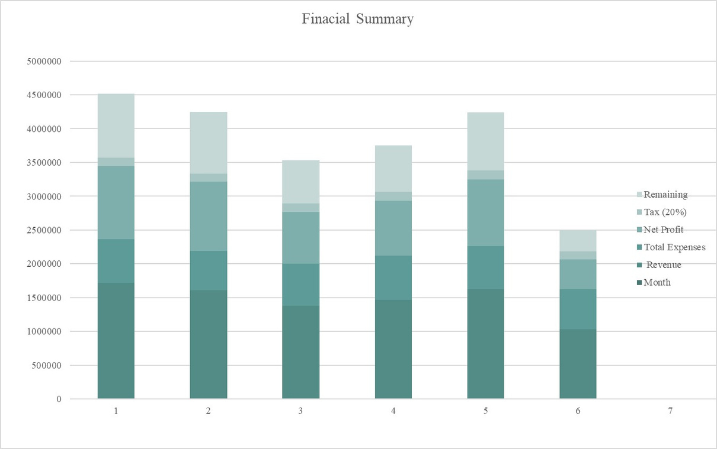
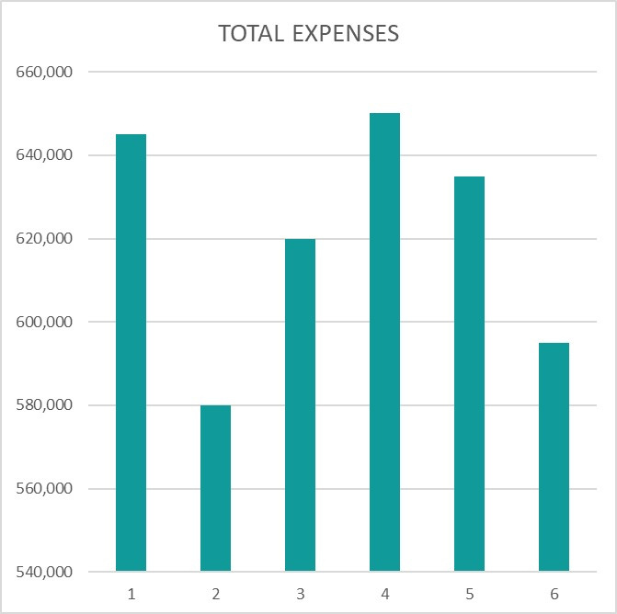
Charts and calculations
We perform calculations on our gross income and our financial summary.

Slide 6

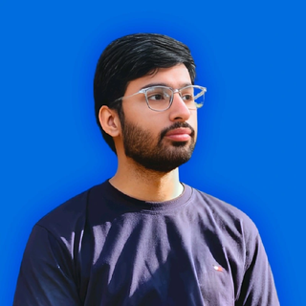
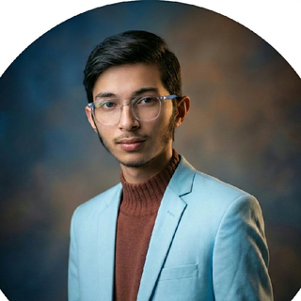


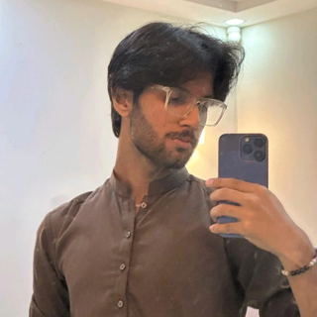
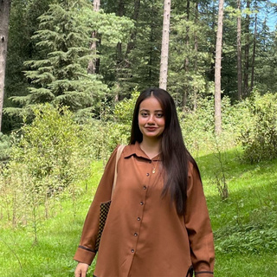
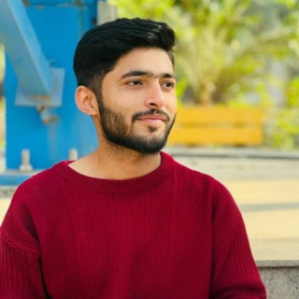
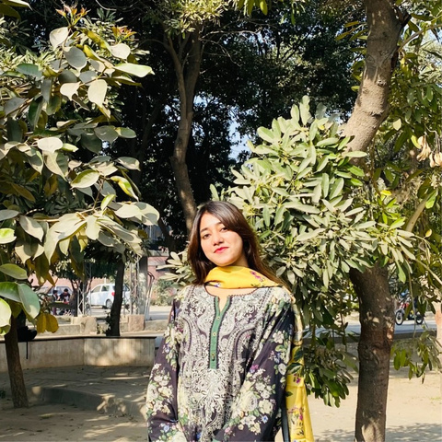
Our Team and Links
Moeez Ahmad
Muhammad Arham
https://github.com/moeezahmad-tech/
https://github.com/Muhammad-Arham-06
https://www.linkedin.com/in/moeez-ahmadd/
https://www.linkedin.com/in/muhammad-arham-11068a340/
Syed Ali Asjad
Alishba Mahmood
https://github.com/SyedAliAsjad1214
https://github.com/alishbah20/Final-AICT-Project
https://www.linkedin.com/in/syed-ali-asjad-9442ab394/
https://www.linkedin.com/in/alishbah-mahmood-9950333a0/
Hasnain Ali
Fatima Batool
https://github.com/husnainazam8475
https://github.com/fatimabatool2219-svg
www.linkedin.com/in/hasnain-ali-b01a913a1
https://www.linkedin.com/in/fatima-batool-69692839a/

Slide 7
SERVICES
WEB DEVELOPMENT
VIDEO EDITING
SEO
We build modern, fast, and easy-to-use websites. From simple landing pages to complex online stores, we create digital spaces that help your business grow and look great on any screen.
We turn raw footage into professional videos that tell a story. Whether it’s for social media, YouTube, or business ads, we make sure your content looks polished, exciting, and catches the viewer's attention.
SEO is like a digital magnet. At TechKreative, we optimize your website so it gets more organic (free) visitors. More traffic from Google means more customers and higher sales for your business.

Slide 8
SERVICES
LINKEDIN
GRAPHIC DESIGNNG
SOCIAL MEDIA
We help you grow your professional brand on LinkedIn. From fixing your profile to posting content that gets likes and comments, we make sure you look like an expert in your field and connect with the right people.
At TechKreative, we turn your ideas into beautiful designs. We make sure your business has a consistent look across all platforms, helping you stand out from the crowd and look better than the competition.
We manage your social media pages so you don't have to. We create posts, talk to your followers, and grow your audience on platforms like Instagram, Facebook, and TikTok to keep your brand active and popular

Slide 9
WHAT WAS LEARNED
We mastered building responsive websites with HTML/CSS and managing data through complex Excel calculations, GitHub, linkedin and managing such a large project with proper team work.
We completed our project with proper division of our work in group members according to their area of expertise and we were there to help each other.
TEAM WORK
IMPORVEMENT
We can still improve a lot of things if we had more time but we did our best to achieve the final result that we have now.

Slide 10



TechKreative
Contact Us
Your All-in-One Digital Partner
+92-xxxxxx-xx
techkreative@gmail.com
Thank you
ww.techkreative.com

